Slide 1
Civics Midterm Review

Slide 2
What we’ve learned so far:
Chapter 3: Citizenship
Chapters 10-12: Political parties and the Media
Chapter 4: Road to independence
Chapter 5: The Constitution
Chapter 6: The Amendments
Stars means you should spend extra time studying.

Slide 3
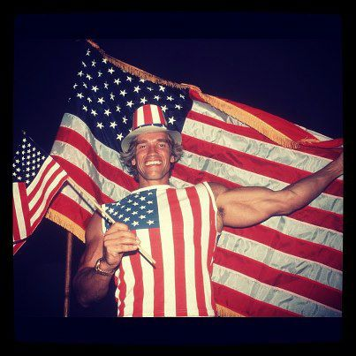
Chapter 3 Highlights
Legal member of a society is a CITIZEN.
Three levels of government: Local, state, federal/national
Two ways to become a U.S Citizen:
1. Birth (Law of soil- Born on U.S Territory) OR (Law of blood- Born to U.S parents)
Naturalization Process

Slide 4
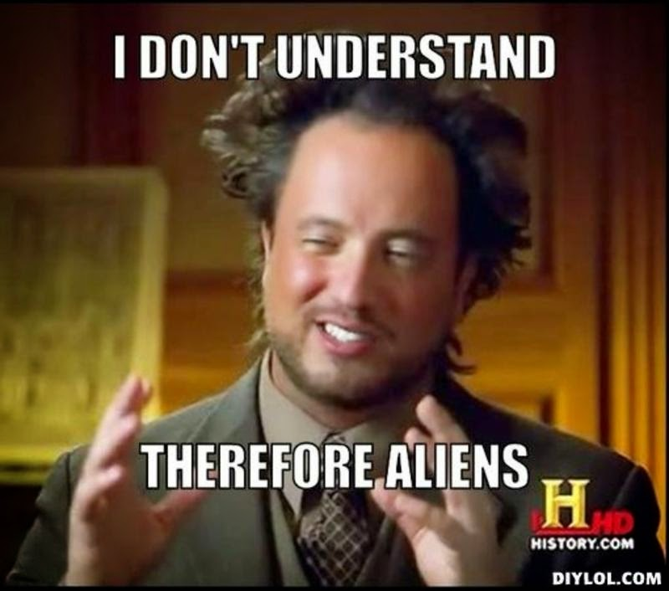
Naturalization process
1. Apply for a green card
2. Declaration of Intent
3. Get fingerprinted
4. Interview and Test
5. Oath of Allegiance

Slide 5
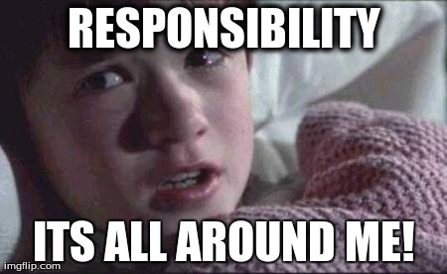
14th Amendment
In our constitution, guarantees citizenship: You have rights.
Duties (something you MUST do):
Pay taxes
Obey the law
Appear in court (jury duty)
Served in the armed forces
Responsibilities (You are NOT required to do):
Vote
Be informed
Take part in government
Participate in the community
Respecting and protecting the rights of others

Slide 6
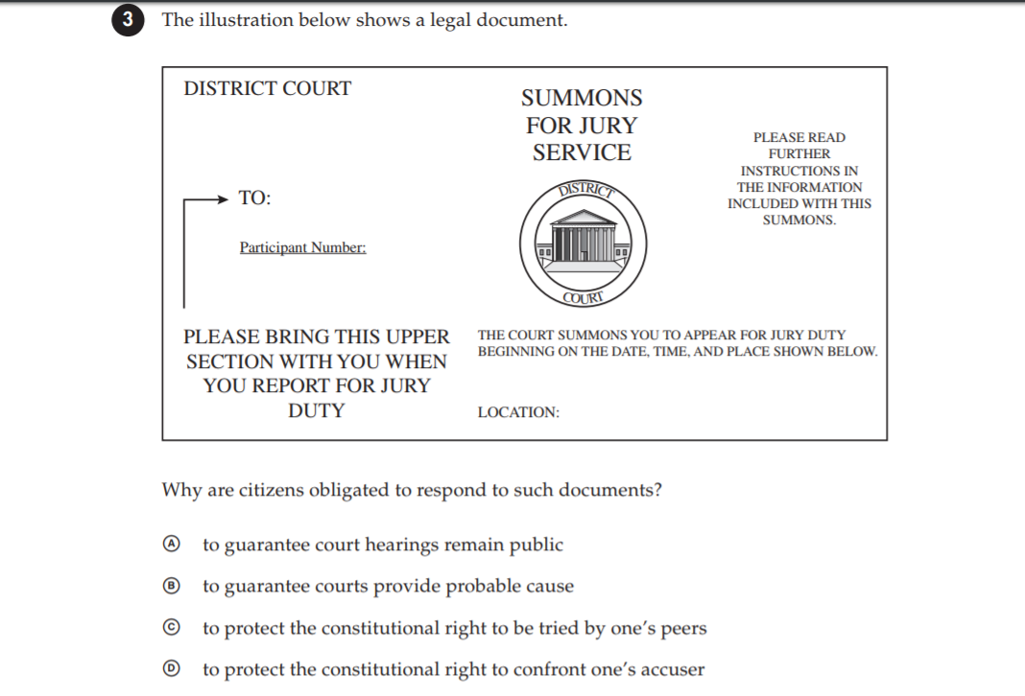
Sample Question

Slide 7
Chapters 10-12
Chapter 10= Political Parties
Chapter 11= Voting and elections
Chapter 12= Public opinion and government

Slide 8
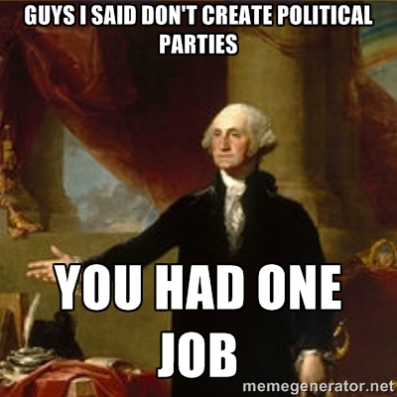
Political parties
A group of citizens (voters) with similar views on public issues who work to put their ideas into effect through government action and who band together to elect candidates. America had a two-party system.
Democrats- Liberal
Republicans- Conservative
3rd party: Libertarian, tea party, green party, etc.

Slide 9
Political spectrum

Slide 10
Basic disagreement of political parties is….
The responsibilities of government AKA how involved the government should be in the lives of the people. Example: More or less taxes for government programs.
Platform: statements that express the core beliefs of a political party.
Plank: individual part of a platform is a plank.

Slide 11
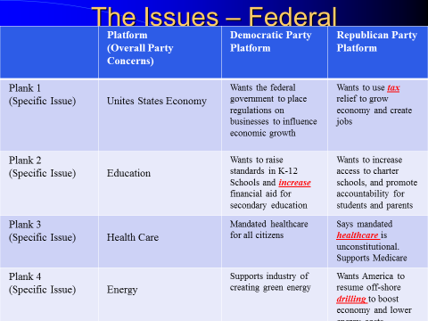
Ex: jobs

Slide 13
Chapter 11- Elections
Primary elections: Elections occur first and help narrow the field of candidates for each political party.
Open: Voters do not declare their party preference.
Closed: Only declared party members can vote for nominees.
General Elections: Voters choose leaders for various offices such as president (sort of), congress, state and local positions.
Vote the first Tuesday after the first Monday
All votes EXCEPT presidential are through popular vote.

Slide 14
Electoral college
Winner takes all system, essentially state legislatures choose the president.
However, their votes are based on state popular vote.
For example: even though some people voted for Hillary Clinton in the 2016 election, more people in Florida (specifically) voted for Donald Trump. Therefore, he got ALL of Florida’s electoral college votes (29), 270 is the magic winning number.
Hillary won the electoral votes for some other states (such as California) but not enough to win.

Slide 16
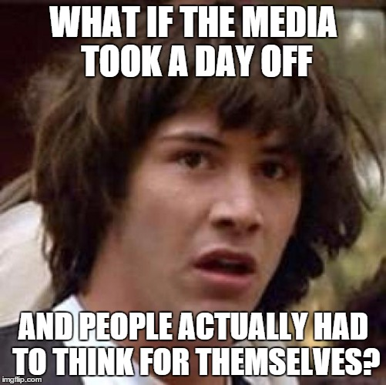
Chapter 12
Influencing the government:
Individuals
interest groups
media

Slide 17
Shapes public opinions
Individuals | Interest Groups | Media
Vote | Economic | Print Media
Petition | Issue-oriented | Electronic Media
Work on campaigns | Public interest
Run for office | Lobbyist: paid representatives who work for interest groups | Watches the government and exposes it when there is corruption.

Slide 19
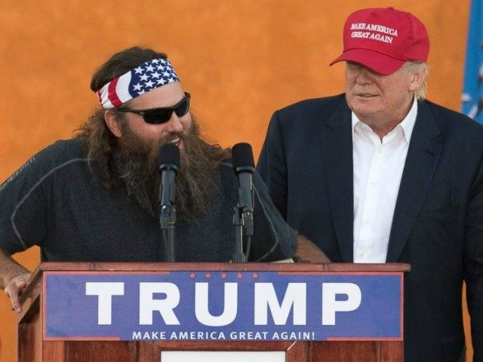
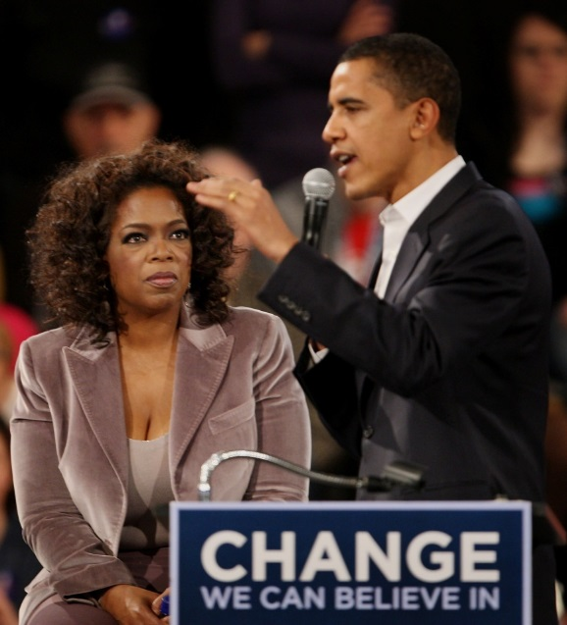
Types of Propaganda
Endorsements/Testimonial
“I’m voting for Candidate A and so should you.”
Stacked Cards
“Candidate A has the best record on the environment”
Name – Calling
- “Candidate A is a dangerous extremist”

Slide 20
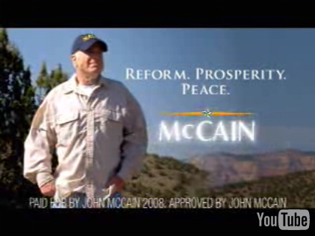
Types of Propaganda
Glittering Generality
“Candidate A is the one who will bring us peace and prosperity”
Transfer Symbols
“I pledge allegiance…..”

Slide 21
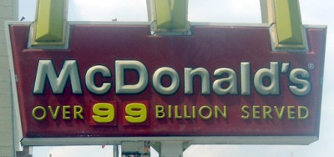
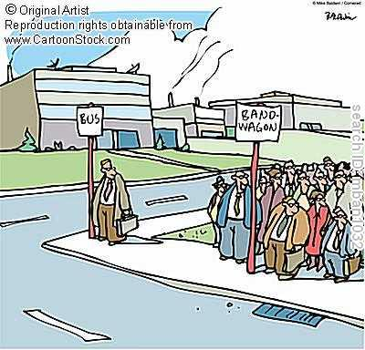
Types of Propaganda
Just Plain Folks
“My parents were ordinary, hardworking people…”
The Bandwagon
“Polls show our candidate is pulling ahead”

Slide 24
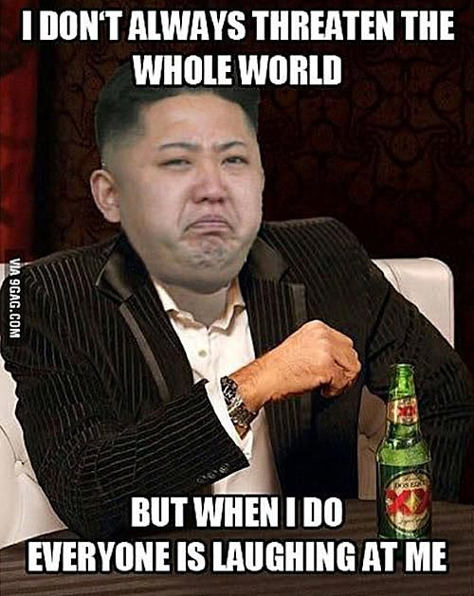
Chapter 4
Types of government
English roots
Declaration of Independence
Nation’s first government

Slide 25
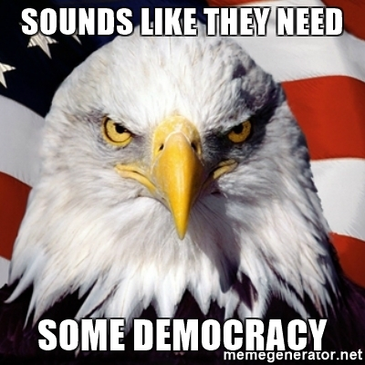
Two main types of Government
Democratic:
Direct
Representative
Nondemocratic:
Monarchy
Autocracy (dictatorship, oligarchy)
Theocracy

Slide 27
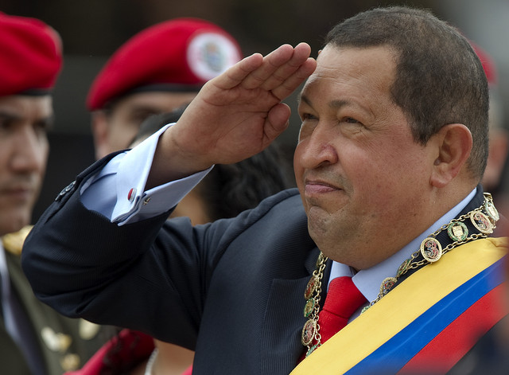
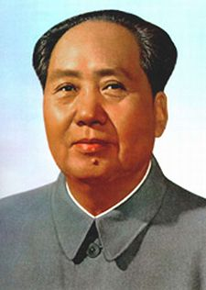
Systems
Socialism is an economic system where a country has power over all goods that are produced and provides all for their people.(Denmark, Canada)
Communism is a form of government where the ruling party owns the means of production and private ownership is restricted. Usually a dictator rules in Communism (China)

Slide 28
America has been influenced by Great Britain in many ways:
1. Magna Carta 1215= Limited the rights of the king, RULE OF LAW.
2. English Bill of Rights 1689: Limited the king’s power over parliament (the people).
3. Mayflower Compact 1620: Pilgrims (in Massachusetts) create a document giving them direct democracy (self-government).

Slide 30
Road to Revolution
English fight the “French and Indian War”
Tax the colonist (stamp act)
Colonist boycott (refuse to buy British goods, some people burn paper goods in protest). “NO TAXATION WITHOUT REPRESENTATION!”
Townshend acts put in place: This act allowed taxes to be levied on basic goods imported to the colonies from Great Britain (glass, tea, paper, etc.)
Colonist protest

Slide 31
Road to Revolution continued…
Tea act: It lowered taxes on British tea --which made merchants have to buy British tea over other tea.
Boston tea party
Coercive acts/intolerable acts: restricted colonists rights, had to quarter soldiers, were not allowed to assemble (meet).
First continental congress (olive branch petition, wanted peace)
Second continental congress (Independence is debated)

Slide 33
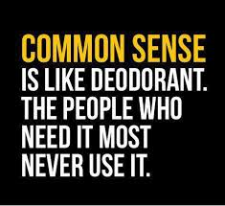
Common sense
Some colonist wanted independence while others did not. Patriots vs. Loyalist.
Thomas Paine writes pamphlets called “Common Sense” detailing why it made sense to part from Britain.
It convinced many people.

Slide 35
Declaration of Independence
Thomas Jefferson is the main author.
List of grievances against the King.
IRCD (Introduction, rights, complaints, declaration).

Slide 36
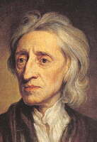
“Declaration of Independence”
Thomas Jefferson was also influenced by the
ideas of John Locke & Baron de Montesquieu
Locke believed in natural law & social contract.
Natural Law means that you are born with certain rights not granted by the government.
“natural rights” that because we are human we are guarantee by the Heavens (God)…life, liberty and property – Jefferson would change this slightly
“social contract” – that people have a contract with their government and the gov’t should protect it’s people. (“Locked into a contract”)
Baron de Montesquieu (“3 Names, 3 Words, 3 Branches”)
Separation of Powers – each branch of government is responsible for specific powers.

Slide 38
First government
Articles of Confederation is our first attempt at government.
It was not strong enough, the states had more power then the federal government, this is called a Confederal government.
Unitary government is when the federal has all the power.
Federal system is when power is shared between, state and federal. This is what the USA has today.
Weaknesses:
No central leadership (executive)
No power to regulate commerce (trade)
No power to enforce it’s laws
No national court system to carry out justice
No power to tax the people. (Left deep in debt)
Any changes made to the Articles required UNANIMOUS consent of all 13 states!!

Slide 39
Getting rid of the AOC
Had to get ride of the Articles of Confederation and began drafting the Constitution at the “Constitutional convention.”

Slide 40
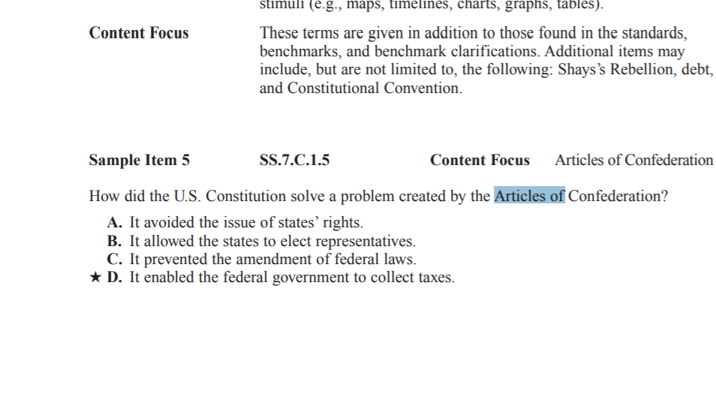

Slide 41
The Constitution
AOC was too weak so the framers (creators of the Constitution/ founding fathers) had to work together to create a new system of government.
Preamble or Introduction to the Constitution:
We the People of the United States, in Order to form a more perfect Union, establish Justice, insure domestic Tranquility, provide for the common defence, promote the general Welfare, and secure the Blessings of Liberty to ourselves and our Posterity, do ordain and establish this Constitution for the United States of America.

Slide 43
How should the states get to vote?
Virginia Plan:
Created a “3 branch” government (Legislative, Executive, & Judicial)
Created a two house bicameral legislature based on POPULATION!
Larger states were in favor of this! (Virginia, Massachusetts, Pennsylvania, & New York)
Smaller states protested because they would lose power due to their populations.
New Jersey Plan:
Created a “3 branch” government (Legislative, Executive, & Judicial)
Called for a one house legislature (unicameral).
This plan called for equal representation -Each state had ONE vote!
Smaller states liked this plan! (New Jersey, Delaware, and Maryland)
This was opposed by larger states who would only have as much power as smaller states despite having larger populations!

Slide 45
The “Great Compromise”
Created the “Senate”
Each state had two (2) votes, both equal.
Pleased the smaller states (put them on equal footing with larger states in this house).
Created the “House of Representatives”.
Each state’s voting status was based on population.
Pleased the larger states (gave them more power in this house).

Slide 47
The battle to ratify the Constitution Ratify means to approve
“Anti-Federalists” felt that it gave too much power to the national government and took too much power from the states.
They opposed the Constitution as it was written & demanded that the new Constitution protect the basic individual rights of the people – they wanted a “bill of rights” added.
“Federalists” were supporters of the Constitution as it was written.
They believed in a strong central government and wanted the document ratified (approved) as it was written.

Slide 48
The Constitution is ratified in 1788
We….
“Popular Sovereignty” = People Rule!!!
Believe in Rule of Law
Federalism- power is shared between federal and state governments
Power is divided
Expressed or Enumerated= powers are specifically given to the federal government.
Reserved = power is shared given to the states.
Concurrent= Powers are shared between federal and state government.
THIS IS EXPLAINED IN THE 10th AMENDMENT!!!!

Slide 49
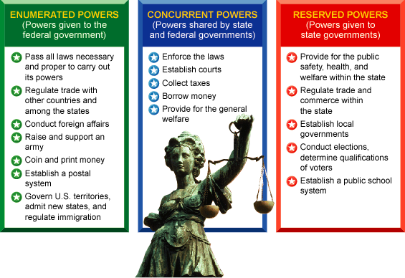
Powers are Divided

Slide 51
Enlightenment Thinkers
Baron de Montesquieu= Separation of powers
John Locke= Natural rights/law (Life, liberty, property)
Jean Rousseau= social contract

Slide 52
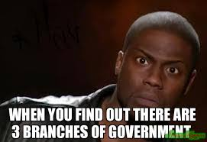
Separation of powers
3 branches of government
Legislative- Makes laws
Executive- enforces laws
Judicial- Interprets laws
Checks and balances= the three branches CHECK each other and BALANCE each other to be sure one group doesn’t become too powerful AND to be sure it is upholding the beliefs of the Constitution.

Slide 53
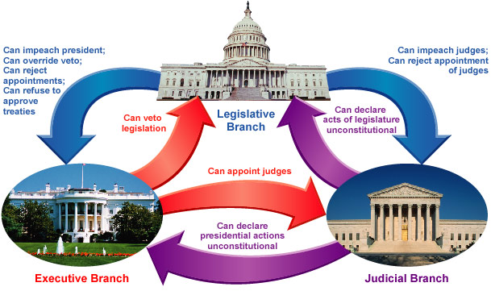
“Checks & Balances”

Slide 54
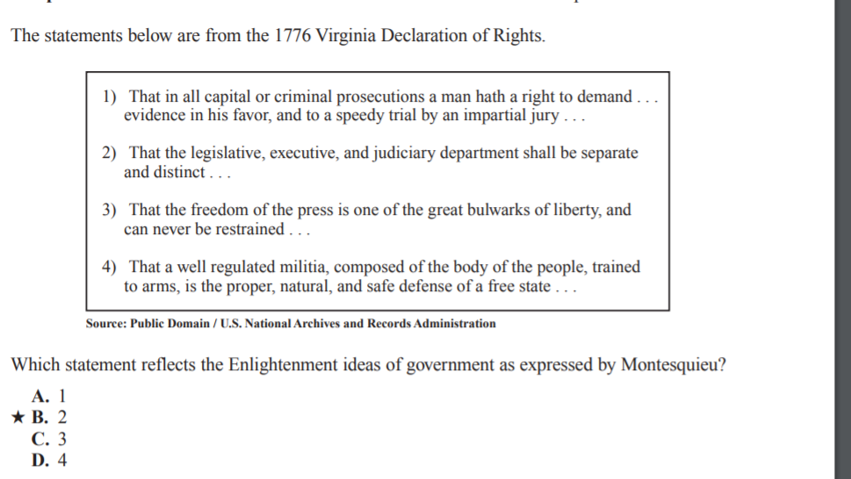

Slide 56
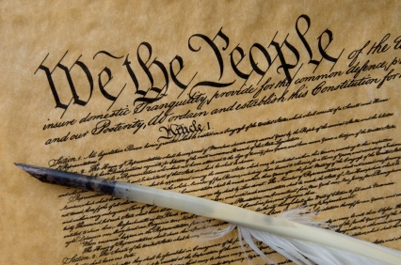
Three Parts of the Constitution
Preamble - Introduction or Goals of the Constitution
The 7 Articles - (LEJ RASR): Body of the Constitution
The 27 Amendments - Changes to the Constitution

Slide 57
Articles of the Constitution
Article 1: establishes Legislative branch
Article 2: establishes Executive branch
Article 3: established judicial branch
Article 4: Promises to protect the states and sets up rights for the citizens
Article 5: Rules for amending or changing the constitution
Article 6: Supremacy – the U.S Constitution is the highest law of the land (it is above all others)
Article 7: Ratification of the constitution

Slide 58
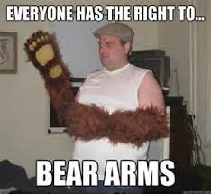
Bill of rights and other Amendments
The first 10 amendments
Gives us civil liberties
There are 27 amendments in total
In order to make an Amendment:
1. An idea must be proposed (vote must be passed by 2/3 of congress)
2. It must be ratified (approved by ¾ of congress)

Slide 59
“R.A.S.S.D.A.T. E.P.S.”
R = Religion, Assembly, Speech, Press, Petition
A = Arms (right to bear arms)
S = Soldier Quartering
S = Search & Seizure (privacy amendment)
D = Double Jeopardy, Due process, eminent Domain and you Don’t have to testify against yourself (rights of the accused) PLEAD THE FIF!
A = Attorney & fair and speedy trial in Criminal Cases
T = Trial by Jury in Civil Cases over $20
E = Excessive Bail or Cruel and Unusual Punishment
P = People’s Rights (we have rights not discussed in the constitution)
S = States Rights (The states are in control of issues/laws NOT in the constitution)

Slide 60
Amendment 11 | Suits Against States
Amendment 12 | Election of President and Vice President
Amendment 13 | Abolition of Slavery
Amendment 14 | Citizenship and Civil Rights
Amendment 15 | Rights of Suffrage
Amendment 16 | Income Taxes
Amendment 17 | Direct Election of Senators
Amendment 18 | Prohibition
Amendment 19 | Women's Rights
Amendment 20 | Presidential and Congressional Terms

Slide 61
Amendment 21 | Repeal of Prohibition
Amendment 22 | Limiting Presidential Terms
Amendment 23 | Suffrage for Washington D.C.
Amendment 24 | Poll Taxes
Amendment 25 | Presidential Succession and Disability
Amendment 26 | Vote for 18-Year Old
Amendment 27 | Congressional Pay Raises

